Slide 1

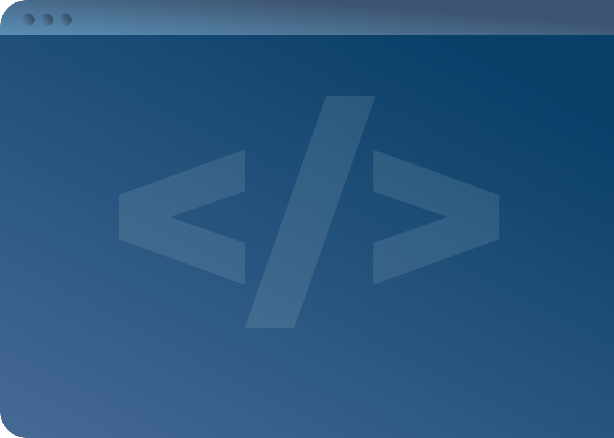

SOFTWARE DEVELOPMENT PROFESSIONAL PROGRAM
Node.js: JavaScript on the Server Side

Slide 2





Node.js: JavaScript on the Server Side
Learning Objectives
Provide a definition and typical use case for Node.js.
Explore the differences between Node.js and front-end JavaScript.
Use npm to install and require third-party code.

Slide 3

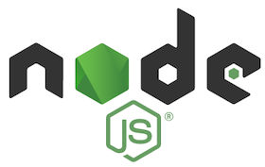
Node.js: JavaScript on the Server Side
What is Node.js?
Q: Is Node.js a separate language from JavaScript?
A: Nope!
Node.js.org
Notes:
Is Node a separate language from JavaScript? Nope! It's JavaScript in another context.

Slide 4
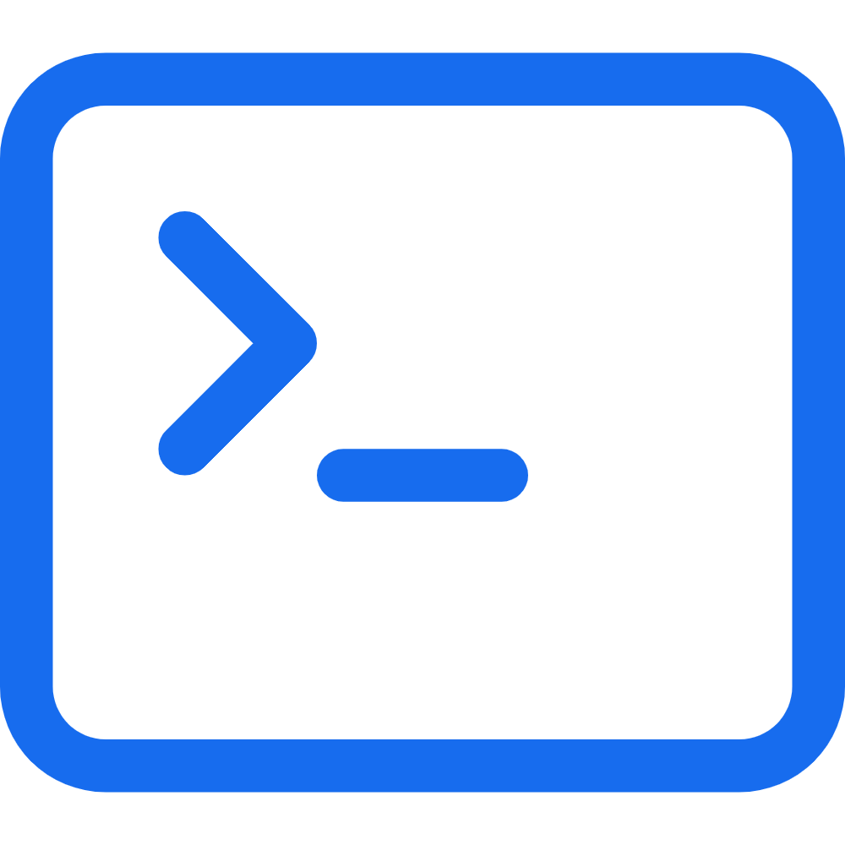
Node.js: JavaScript on the Server Side
What is Node.js?
JavaScript on the Back End
Node.js is a JavaScript runtime environment that decouples JavaScript from a browser. Node can run server-side code or a script apart from the web entirely!
Notes:
Node.js is most often described as "JavaScript on the back end." This can be correct, but it's a simplification.
It's most correct to describe Node.js as a different environment for JavaScript to run in.
Most of the time, as web developers, we will be using Node.js as a back-end language to run a server.

Slide 5

Node.js: JavaScript on the Server Side
Digging a Little Deeper
Node.js runs on the same engine that powers Google Chrome
Similar environments
Familiar code
Predictable behavior
Chrome Logo Image Source
Notes:
One of the nicest things about Node.js is that you do not have to learn a new language or a new syntax to start using it.
Since we already know how to write JavaScript, Node.js should feel familiar to us, even as we venture into the server side!

Slide 6
Node.js: JavaScript on the Server Side
Differences between JS & Node.js
JavaScript | Node.js
Runs in a web browser | Runs outside of a web browser
Can manipulate the DOM | No access to the DOM
Needs libraries for external code | Comes with a package manager: npm
Notes:
For more detailed differences, take a look here: https://nodejs.dev/learn/differences-between-nodejs-and-the-browser

Slide 7
Node.js: JavaScript on the Server Side
Features of Node.js
Node.js gives us several new things:
Keyword require to include modules
Global process variable to access the enviroment
npm to get code other people wrote
...but it loses access to the browser enviroment and direct access to the DOM.
Notes:
A good explanation can be found here: https://www.codecademy.com/articles/what-is-node

Slide 8


Node.js: JavaScript on the Server Side
Think of It Like This
Now we're letting her outside.
Let's say we have a cat.
Amazing new things: flowers and butterflies!
Up until now, she's been an indoor cat, growing up with her sisters...
But she's also missing some old comforts, like her food bowl and her bed.
PixaBay
PixaBay
Notes:
Think of it this way: We have a pet cat who was previously restricted to the indoors. Now that she's a little older, we decide it's okay to let her explore the backyard. There's lots of space and lots of great new things for her to investigate! But she's also away from some of her old comforts, like her bed, water dish, and food bowl. She might do something like drink out of a puddle or fish pond outside, but it won't look exactly like her water dish.
Think of Node.js as a new environment for your familiar pet. You have fun new things to explore, like npm and server-side code, but you'll no longer have direct access to the HTML in your webpages.

Slide 9

Node.js: JavaScript on the Server Side
What Is npm?
Node Package Manager
A public directory of node modules
Think of it as a library where you can check out code with a specific function.
GitHub
Notes:
npm is where you can get third-party code.

Slide 10
Node.js: JavaScript on the Server Side
Module vs. Package?
These terms are often used interchangeably! Here's the difference:
For example, a shapes package might include modules like:
Module
Package
A single JavaScript file with inter-related functionality
One or more related modules packaged together
Square.js
Triangle.js
Circle.js
Notes:
Packages group together modules that are related. For example, a shapes drawing package might include specific modules for circles, triangles, or any other shapes.
The triangle module would include all functionality specific to triangles. For example, it would know whether a triangle was acute, obtuse, or right; it might include the Pythagorean theorem, etc.

Slide 11
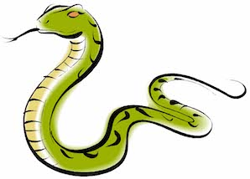
Node.js: JavaScript on the Server Side
Sample Package
Let's take a look at an example package.
Today, we'll look at Snake-Names!
(For all those times when you don't know what to call a snake...)
Pixy
Notes:
https://www.npmjs.com/package/snake-names
Briefly discuss the sections:
- Installation (we install on the terminal; more on that in a moment.)
- Usage (here is how some sample code would look).
- API (here are the available methods we can call).

Slide 12
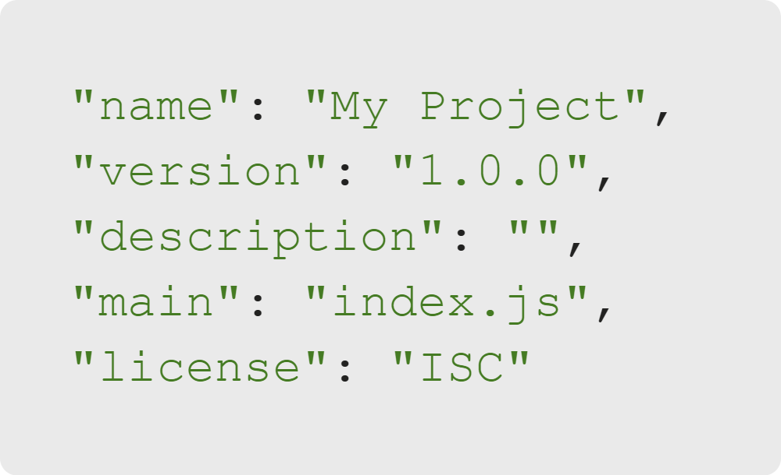
Node.js: JavaScript on the Server Side
npm Init
The npm init command creates a package.json file.
Package.json contains metadata about a project.
Notes:
Instructor Note: Demo to the class, but direct them NOT to follow along. They will do this for the activity. A student's install of Node.js likely already included npm, so they should be ready for their activity.
When you want to use npm in a project, you start by running the command 'npm init,' which creates a package.json file for you.
Protip: The '-y' flag says yes to all the questions 'npm init' asks. Run 'npm init -y' to skip the questions!

Slide 13
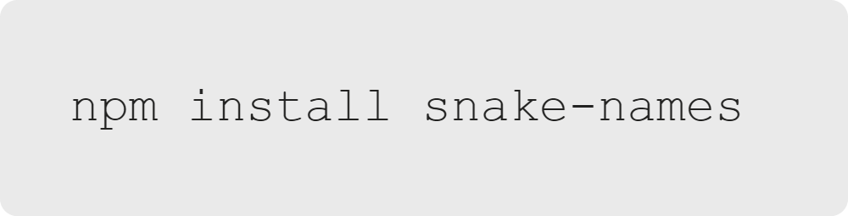
Node.js: JavaScript on the Server Side
npm Install
The npm install [package name] command is used to install a package.
Take a look at package.json now. Has anything changed?
Notes:
Any package registered on npm is findable this way.
You can specify multiple packages separated by a space in a single command.

Slide 14
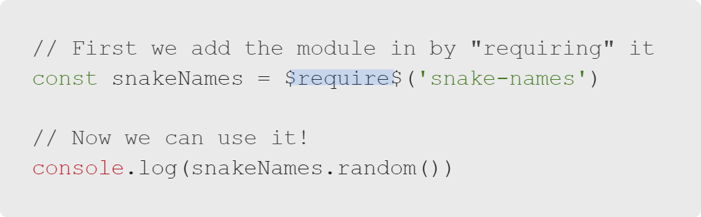
Node.js: JavaScript on the Server Side
Require Keyword
Notes:
One final step is required before we get to start playing with snake names.
We need to *require* the module to add it in and start using it as part of our code.

Slide 15


Node.js: JavaScript on the Server Side
Let's Get to It
Let's do an activity to play around with these new features!
PixaBay
Notes:
Instructor Note: Move into the lab activity.

